Slide 1
Decomposition Techniques
So how does one decompose a task into various subtasks?
While there is no single recipe that works for all problems, we present a set of commonly used techniques that apply to broad classes of problems. These include:
• recursive decomposition
• data decomposition
• exploratory decomposition
• speculative decomposition

Slide 2
Recursive Decomposition
Generally suited to problems that are solved using the divide-and-conquer strategy.
A given problem is first decomposed into a set of sub-problems.
These sub-problems are recursively decomposed further until a desired granularity is reached.

Slide 3
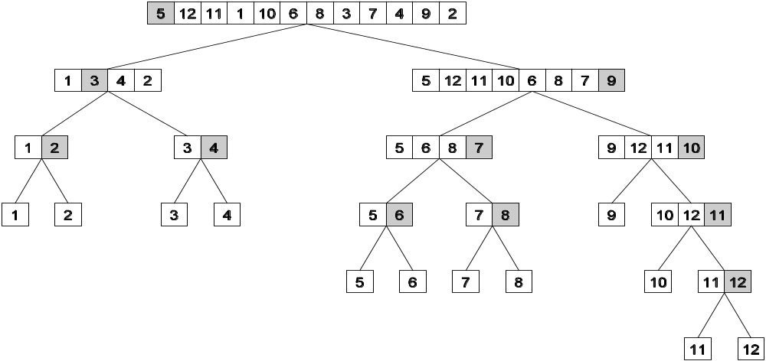
Recursive Decomposition: Example
A classic example of a divide-and-conquer algorithm on which we
can apply recursive decomposition is Quicksort.
In this example, once the list has been partitioned around the pivot, each sublist can be processed concurrently (i.e., each sublist represents an independent subtask). This can be repeated recursively.

Slide 4
Recursive Decomposition: Example
The problem of finding the minimum number in a given list (or indeed any other associative operation such as sum, AND, etc.) can be fashioned as a divide-and-conquer algorithm. The following algorithm illustrates this.
We first start with a simple serial loop for computing the minimum entry in a given list:
1. procedure SERIAL_MIN (A, n)
2. begin
3. min = A[0];
4. for i := 1 to n − 1 do
5. if (A[i] < min) min := A[i];
6. endfor;
7. return min;
8. end SERIAL_MIN

Slide 5
Recursive Decomposition: Example
We can rewrite the loop as follows:
1. procedure RECURSIVE_MIN (A, n)
2. begin
3. if ( n = 1 ) then
4. min := A [0] ;
5. else
6. lmin := RECURSIVE_MIN ( A, n/2 );
7. rmin := RECURSIVE_MIN ( &(A[n/2]), n - n/2 );
8. if (lmin < rmin) then
9. min := lmin;
10. else
11. min := rmin;
12. endelse;
13. endelse;
14. return min;
15. end RECURSIVE_MIN

Slide 6
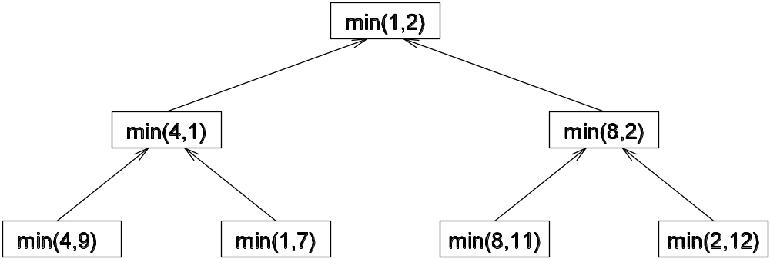
Recursive Decomposition: Example
The code in the previous foil can be decomposed naturally using a recursive decomposition strategy. We illustrate this with the following example of finding the minimum number in the set {4, 9, 1, 7, 8, 11, 2, 12}. The task dependency graph associated with this computation is as follows:

Slide 7
Data Decomposition
Identify the data on which computations are performed.
Partition this data across various tasks.
This partitioning induces a decomposition of the problem.
Data can be partitioned in various ways - this critically impacts performance of a parallel algorithm.

Slide 8
Data Decomposition: Output Data Decomposition
Often, each element of the output can be computed independently of others (but simply as a function of the input).
A partition of the output across tasks decomposes the problem naturally.

Slide 9
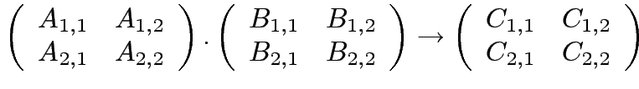




Output Data Decomposition: Example
Consider the problem of multiplying two n x n matrices A and B to yield matrix C. The output matrix C can be partitioned into four tasks as follows:
Task 1:
Task 2:
Task 3:
Task 4:

Slide 10
Output Data Decomposition: Example
A partitioning of output data does not result in a unique decomposition into tasks. For example, for the same problem as in previus foil, with identical output data distribution, we can derive the following two (other) decompositions:
Decomposition I | Decomposition II
Task 1: C_{1,1} = A_{1,1} B_{1,1} Task 2: C_{1,1} = C_{1,1} + A_{1,2} B_{2,1} Task 3: C_{1,2} = A_{1,1} B_{1,2} Task 4: C_{1,2} = C_{1,2} + A_{1,2} B_{2,2} Task 5: C_{2,1} = A_{2,1} B_{1,1} Task 6: C_{2,1} = C_{2,1} + A_{2,2} B_{2,1} Task 7: C_{2,2} = A_{2,1} B_{1,2} Task 8: C_{2,2} = C_{2,2} + A_{2,2} B_{2,2} | Task 1: C_{1,1} = A_{1,1} B_{1,1} Task 2: C_{1,1} = C_{1,1} + A_{1,2} B_{2,1} Task 3: C_{1,2} = A_{1,2} B_{2,2} Task 4: C_{1,2} = C_{1,2} + A_{1,1} B_{1,2} Task 5: C_{2,1} = A_{2,2} B_{2,1} Task 6: C_{2,1} = C_{2,1} + A_{2,1} B_{1,1} Task 7: C_{2,2} = A_{2,1} B_{1,2} Task 8: C_{2,2} = C_{2,2} + A_{2,2} B_{2,2}

Slide 11
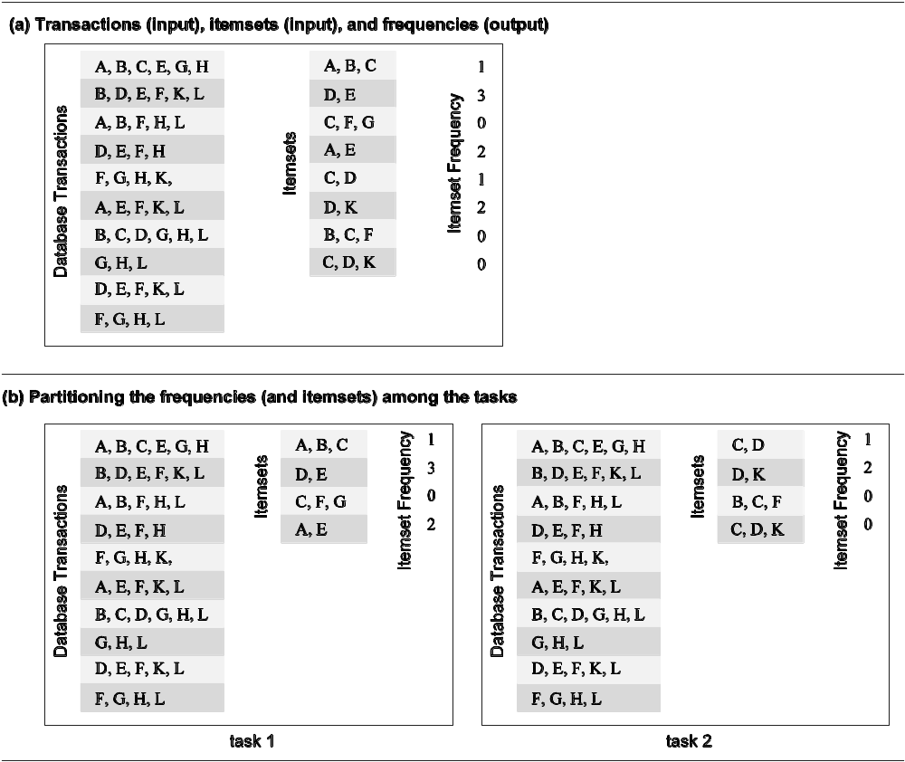
Output Data Decomposition: Example
Consider the problem of counting the instances of given itemsets in a database of transactions. In this case, the output (itemset frequencies) can be partitioned across tasks.

Slide 12
Output Data Decomposition: Example
From the previous example, the following observations can be made:
If the database of transactions is replicated across the processes, each task can be independently accomplished with no communication.
If the database is partitioned across processes as well (for reasons of memory utilization), each task first computes partial counts. These counts are then aggregated at the appropriate task.

